Slide 1


Towards Stateless RNIC for Data Center Networks
Pulin Pan
Guo Chen
Xizheng Wang
Huichen Dai
Bojie Li
Binzhang Fu
Kun Tan
Hunan University
Huawei
Notes:
Hello everyone, my name is Guo Chen. I’m an Associate Professor from Hunan University. Today I’m going to talk about ... This is a joint work with ...

Slide 2
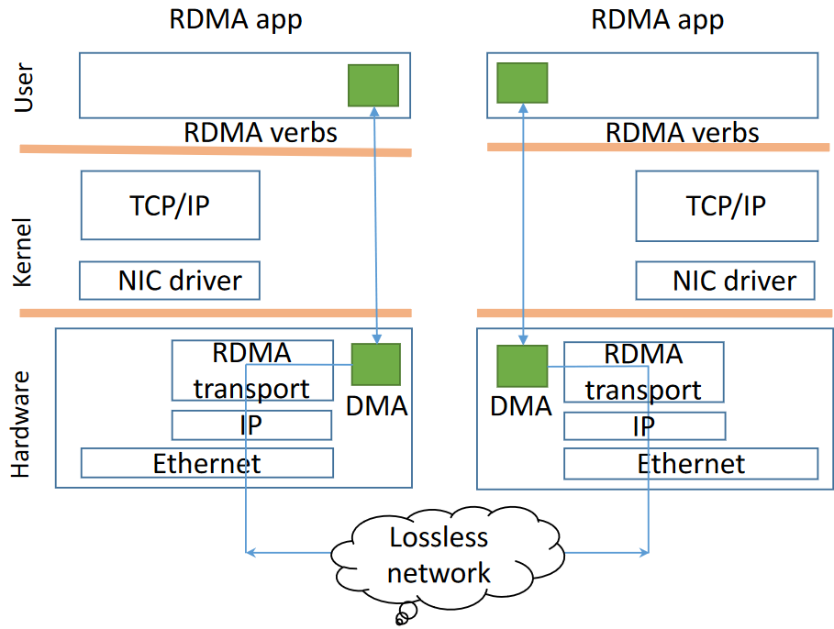
RDMA background
RDMA is becoming prevalent in DCN
Low and stable latency, e.g., < 10us; High throughput, e.g. , 100Gbps; Low CPU overhead
Widely deployed in companies such as Microsoft, Alibaba, ByteDance
Network stack in NIC
Processing in dedicated NIC hardware
Bypass kernel
Zero copy
Notes:
To address this problem, RDMA hardware stack is becoming prevalent in DCN.
Compared to TCP/IP, RDMA offers very low and stable latency, high throughput, and very low CPU utilization. With such high-performance, RDMA has been widely deployed in DCN such as in Microsoft.
Actually, the ultra-performance of RDMA comes from implementing the whole network stack in the NIC. As such, the stack processing is done by dedicated high-performance NIC hardware, without involving CPU and OS kernel (which contributes the most performance variance), and directly send/receive data from/to application buffer through NIC.

Slide 3
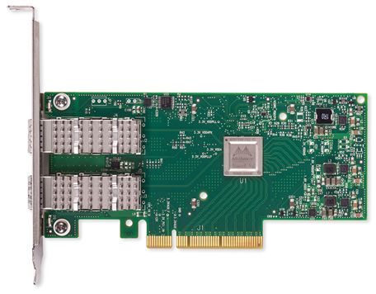
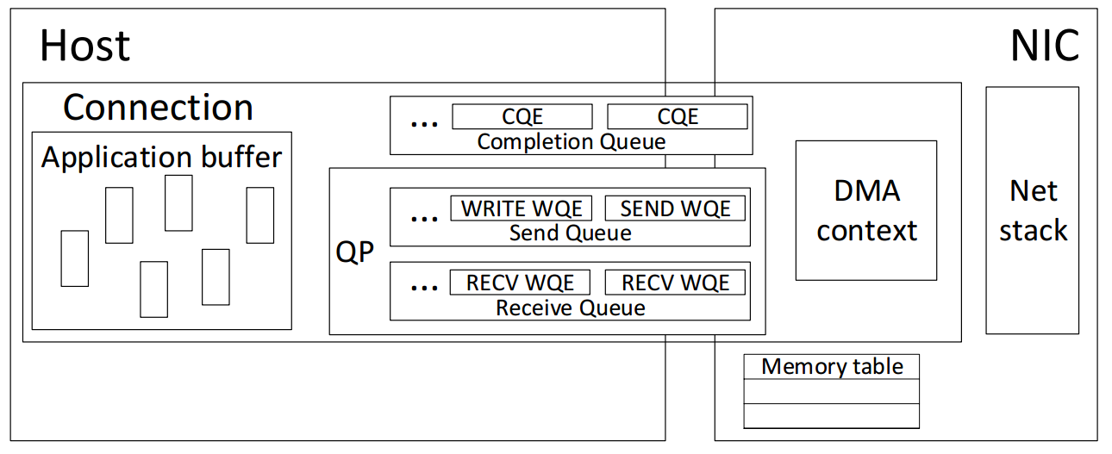
Uniqueness of RDMA stack
Network stack on RDMA NIC (RNIC)
Maintain massive connection-related states on RNIC
Memory-access related
page size, WQ length, …
Networking related
congestion window, recv next, IP address, …
e.g., MLX maintains 256B states for each RDMA connection (/include/linux/mlx4/qp.h mlx4_qp_context)
Still growing…
Notes:
However, the side-effect of offloading network stack on NIC is that we have to maintain massive states on RDMA NIC for stack processing.
Specifically, for each RDMA connection, the NIC needs to maintain memory-access related states, including page size, WQ length, etc., and networking related states, such as congestin window, recv next sequence, IP address.
This figure illustrates the states that an RDMA NIC needs to maintain for stack processing for one connection. In practice, an RDMA connection is operated based on a queue pair, and its states are wrapped in a data structure called queue pair context. Such queue pair context is growing larger and larger, as the stack functionalities become more complicated, for example, for MLX4, the QP context is 256B.

Slide 4
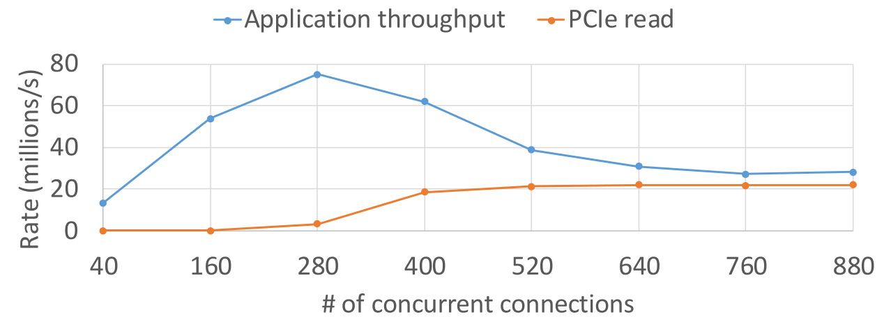
States on RNIC limit the scalability
Host memory
Conn States
RNIC
NIC on-chip memory is scarce (e.g., several Mbs)
Serves as a cache for connection states
Receive data/ACK
Conn States
Conn States
Send out
…
Fetch through PCIe
Conn States
Performance drops when # of concurrent connections grows
State miss on RNIC
Fetch states from host memory
PCIe latency becomes bottleneck
Notes:
While offloading network stack gives RDMA ultra-high-performance, the connection states limit RDMA NIC’s scalability.
Specifically, different from the DRAM on the host, the NIC on-chip memory is very scarce. Therefore, the NIC memory often serves as a cache for connection states. And the whole states of all connections are stored in the host memory when there are too many connections for the NIC memory.
Consequently, the RDMA NIC performance drops a lot when there are too many concurrent connections. Specifically, many connections states are missed on the NIC. When receiving or sending data belong to those connections whose states are not on the NIC, the NIC has to fetch states from the host memory, typically through PCIe bus. Before the states have been fetched, the stack processing needs to stall since it does not know how to process. Under such condition, the PCIe latency becomes the performance bottleneck.
This figure shows our measurement results on MLX4 100G RDMA NIC. We use multiple client RNICs WRITE to one server RNIC using multiple concurrent connections. Results show that when the # of concurrent connections grow beyond 280, the overall throughput drops dramatically, and converge to only about ¼ of the maximum throughput. Meanwhile, we monitored on the server’s PCIe bus and find the number of PCIe read events suddenly grows. This verifies that the NIC is frequently fetching states from the host memory.

Slide 5
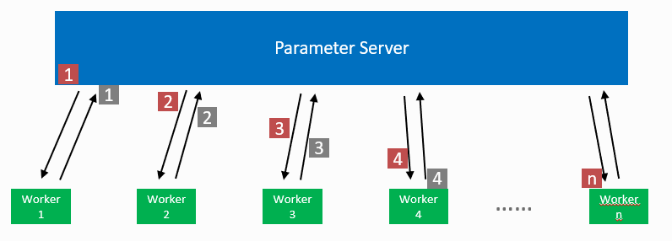
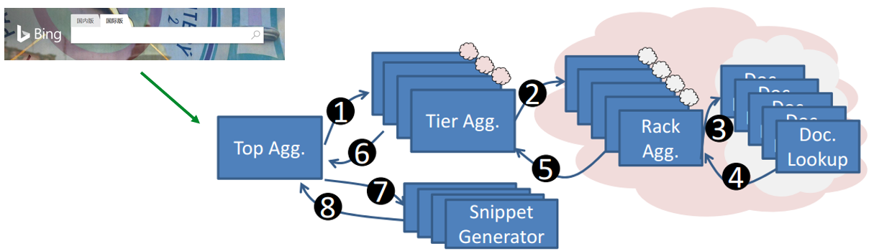
Current status
Applications require high performance under high concurrency, e.g.,
Distributed machine learning
Parameter servers exchange parameters with many worker nodes
Web-search back-end services
Result-aggregators aggregates results from many document-lookupers
Existing works try to avoid/mitigate the impact of the RNIC scalability issue, requiring careful and constrained usage of applications
Using large memory pages [1], connection grouping [2], or unreliable datagram [3], …
Can we directly solve this RNIC scalability problem?
[1] FaRM: fast remote memory, NSDI 2014
[2] Scalable RDMA RPC on Reliable Connection with Efficient Resource Sharing, EuroSys 2019
[3] FaSST: Fast, Scalable and Simple Distributed Transactions with Two-Sided (RDMA) Datagram RPCs, OSDI 2016
Notes:
Now we know that RNIC has performance problem under high concurrency, which is due to connection states miss.
But, current applications do require RNIC has high performance under high concurrency.
To name a few such applications, for example, distributed machine learning system is very popular now. In such systems, the parameter servers need to frequently exchange parameters and gradients with many worker nodes. The communication speed is very critical to the whole system’s performance.
Another example, in web-search back-end services, a search task is distributed to many document lookup nodes. The lookup nodes concurrently search the result, and then the results are collected and aggregated by a few aggregator nodes, then rendered to the user. In such architecture, the aggregator needs to communicate with many lookup nodes efficiently.
Therefore, when applying RDMA for these application, the applications have to be very careful and often have very constrained usage on the RDMA verbs, thus to avoid or mitigate the impact of the RNIC scalability issue. For example, to support multiple connections, they use large memory pages, xxx, or even.
But till now, the RNIC scalability problem has not been solved.
In this work we try to directly tackle the problem

Slide 6
StaR: Towards stateless RNIC
Moving states to the other communication side
Maintain zero connection-related states, while all the RDMA data plane processing is still done by NIC hardware
Utilizing asymmetric communication pattern in DCN
Often only one side has huge fan-in/fan-out traffic while the other side only has a few connections
Parameter servers and workers in distributed machine learning systems
Result-aggregators and document-lookupers in web-search back-end services
…
server
clients
…
Notes:
In this work, we try to solve this dilemma by StaR, which offloads the network stack on RNIC, but makes the RNIC to be still stateless.
This may sound impossible at the first time. Our trick is to move the stack states to the other side.

Slide 7
StaR overview
Host
NIC
NIC
Host
DMA or notify apps
SQ
Mem table
Receive packet/ACK
Conn
RQ
Local
SQ
CQ
Net states
Process based on each packet
Network
RQ
Conn
SQ
Mem table
Embed server states
RQ
CQ
Remote
CQ
Net states
Send packet/ACK
Stateless (Server) side
Stateful (Client) side

Slide 8
Stateless NIC processing
Example #1
Client SEND, Server RECV
App: RECV
App: SEND
Host
NIC
NIC
Host
Data packet
SQ
Mem table
Get ACK header info
Conn
Get DMA info
RQ
Local
SQ
CQ
Net states
Network
RQ
Conn
Encapsulate DMA info
WQEP
Encapsulate network transmission info
CQEP
SQ
Mem table
RQ
CQ
ACK
Remote
CQ
Net states
Stateless (Server) side
Stateful (Client) side

Slide 9
Stateless NIC processing
Example #2
Server WRITE
App: WRITE
Host
NIC
NIC
Host
Get header info
GD packet
SQ
Mem table
Conn
Get DMA info
RQ
Local
SQ
CQ
Net states
Network
Encapsulate DMA info
RQ
Conn
Data packet
WQEP
Encapsulate network transmission info
SQ
Mem table
RQ
CQ
Remote
CQ
Net states
Stateless (Server) side
Stateful (Client) side

Slide 10
Security issue
Without any states, RNIC cannot conduct security check on received packets
May access illegal memory address and trigger malicious traffic
Conduct security check on the client side!
Stateless (server) side
Host
APP
NIC
stateless processing
Generate white list to the security module
Host
NIC
NIC
Host
Network
Network Stack
Security Check
Security Check
Network Stack
APP
APP
Stateful (client) Side
Trustable packet
Trustable packet
Stateful (client) Side

Slide 11
Stateless processing V.S. normal RNIC
RNIC should saturate the link bandwidth
Both StaR RNIC and normal RNIC require a short data packet buffer to fill the pipeline
To cover the delay of processing one packet
However, normal RNICs require another connection state buffer
Should be large enough to store all the connection states of those packets in the pipeline
Consume a lot of memory when data packets are small
Normal RNIC
StaR RNIC
Require no connection state buffer!
Connection state buffer
Packet buffer
Packet buffer

Slide 12
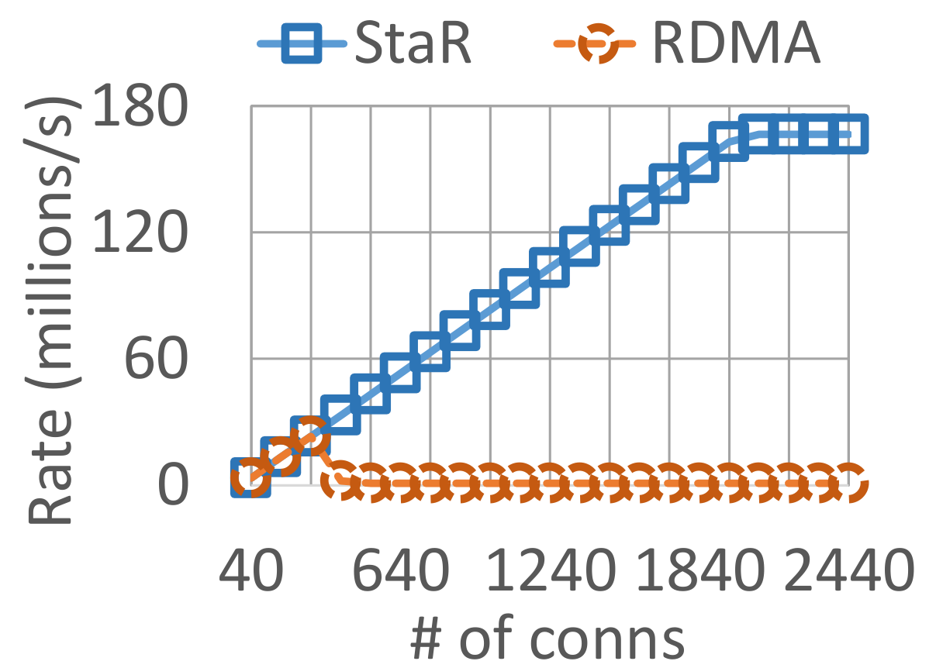
Performance evaluation
Preliminary simulation in NS3
Scenario #1: Stress test
Multiple clients continuously WRITE 8B data to the server
1 outbounding WRITE at any moment
100Gbps link, 12us RTT, 1us PCIe latency, NIC memory of 300 conn states
160x throughput improvement
Server
(Stateless)
Clients
(Stateful)
…
WRITE

Slide 13
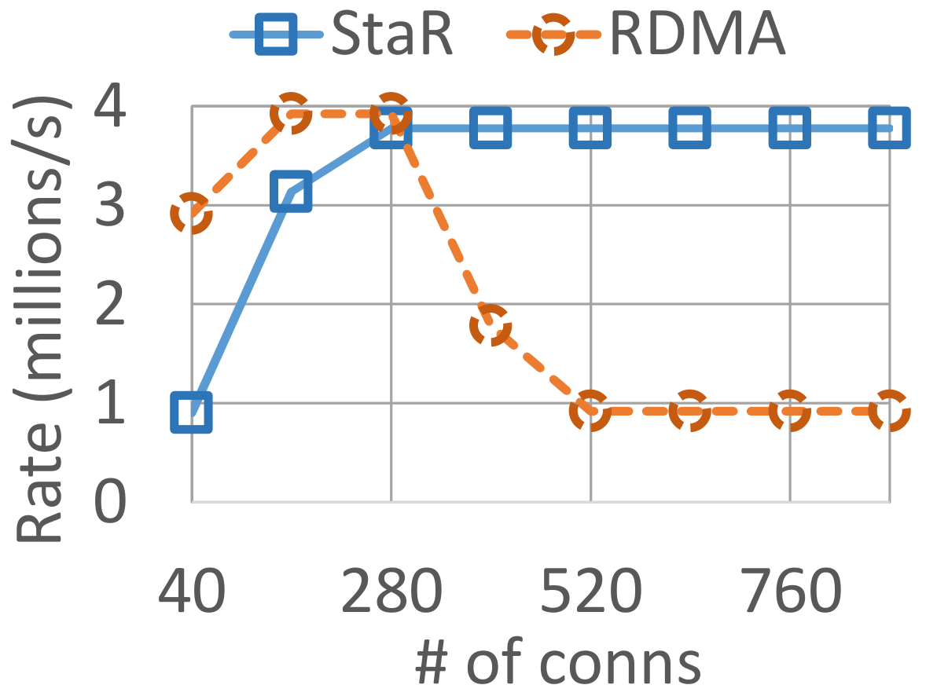
Performance evaluation
Scenario #2: RPC application
Multiple clients continuously call the remote procedure in one server
A 2.8KB RPC request (through SEND/RECV), and an 1.4KB RPC response (through SEND/RECV) after receiving the request.
100Gbps link, 12us RTT, 1us PCIe latency , NIC memory of 300 conn states
4x throughput improvement
Server
(Stateless)
Clients
(Stateful)
…
RPC request
(SEND/RECV)
RPC response
(SEND/RECV)

Slide 14
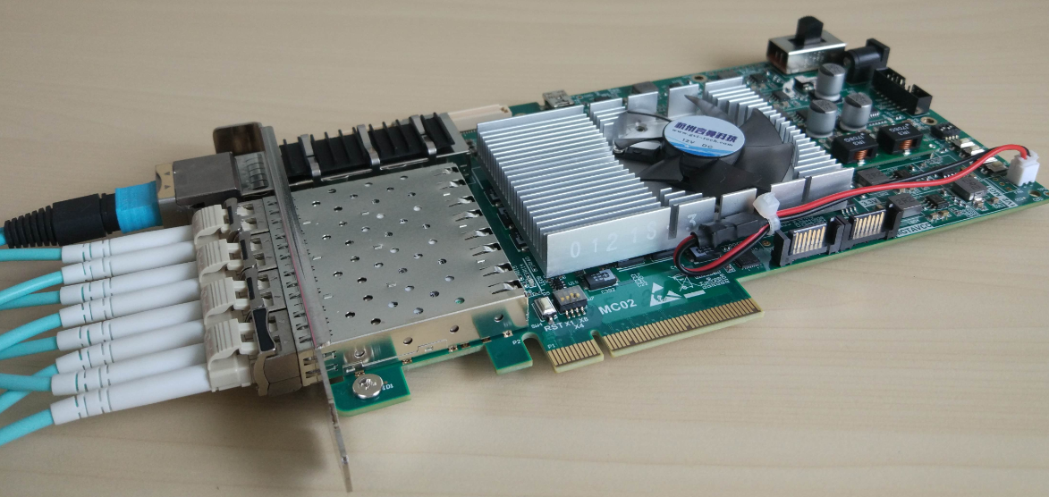
Implementation (ongoing)
FPGA-based smart NIC
Xilinx FPGA board
4 SFP+ (10Gbps), PCIE3.0x8

Slide 15
Implementation (ongoing)

Slide 16
Wrap-up
RDMA achieves high-performance by offloading network stack on RNIC, but, states on RNIC limit its scalability
StaR makes RNIC stateless, by moving states to the other side
Utilizing the asymmetric traffic pattern in DCN
Track application operations (WQE) and transmission states on the other side
Ensure security of the stateless side by controlling the traffic sent out on the stateful side
StaR RNIC breaks the scalability limitation, which may enable cooler RDMA applications

Slide 17
Q&A Thanks!

